Slide 1
Java Architecture
JVM, JRE AND JDK

Slide 2
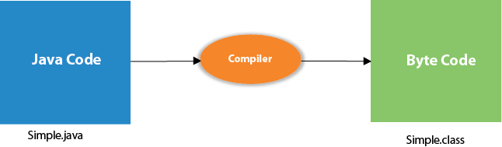
JVM
JVM (Java Virtual Machine) is an abstract machine. It is called a virtual machine because it doesn't physically exist.
It is a specification that provides a runtime environment in which Java bytecode can be executed.
It can also compile the other language codes to JAVA bytecode by loading verifying and executing the code.
JVMs are available for many hardware and software platforms. JVM, JRE, and JDK are platform dependent because each OS’s configuration is different.

Slide 3
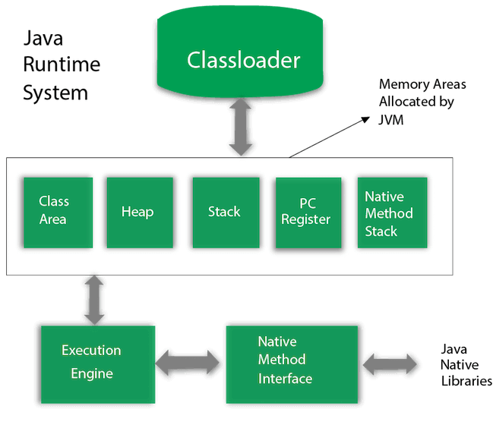
JVM

Slide 4
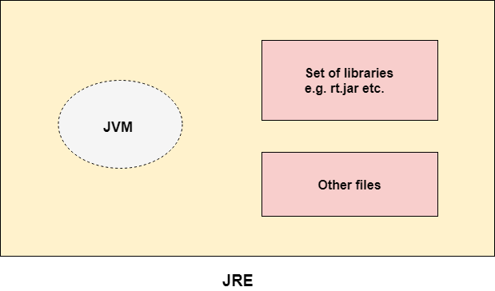
JRE
JRE is an acronym for Java Runtime Environment.
The Java Runtime Environment is a set of software tools which are used for developing Java applications.
It is used to provide the runtime environment. It is the implementation of JVM.
It physically exists.
It contains a set of libraries + other files that JVM uses at runtime.

Slide 5
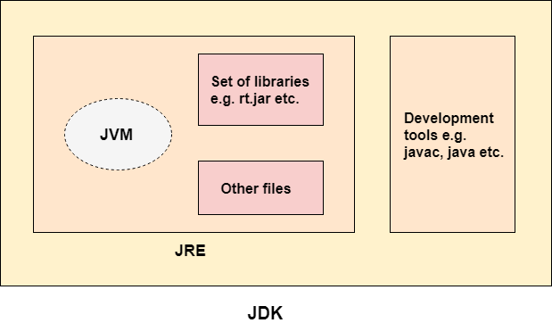
JDK
JDK is an acronym for Java Development Kit.
The Java Development Kit (JDK) is a software development environment that is used to develop Java applications and applets.
It contains Java Runtime Environment and development tools used to create a Java Application.

